Slide 1
Association Rule Mining

Slide 2
FP-growth Algorithm
Use a compressed representation of the database using an FP-tree
Once an FP-tree has been constructed, it uses a recursive divide-and-conquer approach to mine the frequent itemsets

Slide 3
FP Growth Algorithm
NO candidate Generation
A divide-and-conquer methodology: decompose mining tasks into smaller ones
Requires 2 scans of the Transaction DB
2 Phase algorithm
Phase I
    Construct FP tree (Requires 2 TDB scans)
Phase II
    Uses FP tree (TDB is not used)
    FP tree contains all information about FIs

Slide 4
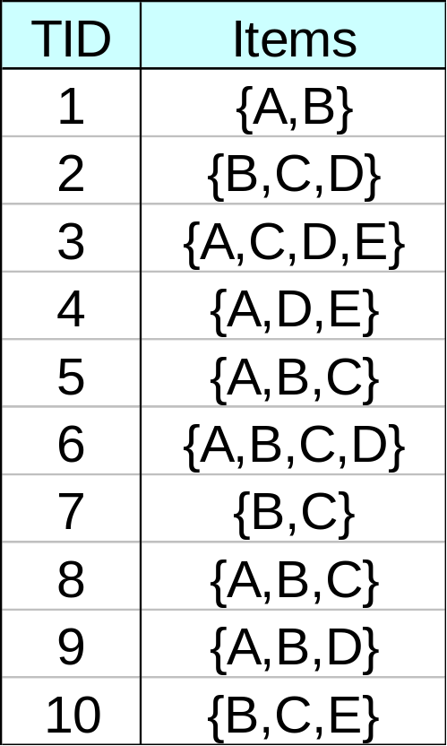
FP-tree construction
null
After reading TID=1:
A:1
B:1
After reading TID=2:
null
A:1
B:1
B:1
C:1
D:1

Slide 5
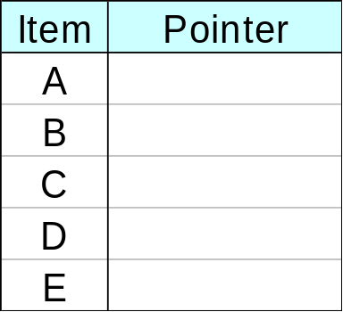
FP-Tree Construction
Transaction Database
null
A:8
B:3
B:5
C:3
C:1
D:1
Header table
D:1
C:3
E:1
D:1
E:1
D:1
E:1
D:1
Pointers are used to assist frequent itemset generation

Slide 6
FP-growth
Conditional Pattern base for D:
P = {(A:1,B:1,C:1),
(A:1,B:1),
(A:1,C:1),
(A:1),
(B:1,C:1)}
Recursively apply FP-growth on P
Frequent Itemsets found (with sup > 1):
AD, BD, CD, ACD, BCD
null
A:8
B:1
B:5
C:1
C:1
D:1
C:3
D:1
D:1
D:1
D:1

Slide 7
Steps in FP-Growth Algorithm
Given: Transaction DB
Step 1: Support_count for each item
Step 2: Header Table (ignore non-frequent items)
Step 3: Reduced DB (ordered FIs for each tx.)
Step 4: Build FP-tree
Step 5: Construct conditional pattern base for each node in FP tree (enumerate all paths leading to that node). Each item will have a conditional pattern base which may contain many paths
Step 6: Construct conditional FP-tree

Slide 8
Construct FP-tree from a Transaction DB: Steps 1-4
TID Items bought (ordered) frequent items
100 {f, a, c, d, g, i, m, p} {f, c, a, m, p}
200 {a, b, c, f, l, m, o} {f, c, a, b, m}
300 {b, f, h, j, o} {f, b}
400 {b, c, k, s, p} {c, b, p}
500 {a, f, c, e, l, p, m, n} {f, c, a, m, p}
{}
Steps:
Scan DB once, find frequent 1-itemset (single item pattern)
Order frequent items in frequency descending order
Scan DB again, construct FP-tree
Header Table L
Item frequency node-links
f 4
c 4
a 3
b 3
m 3
p 3
f:4
c:1
c:3
b:1
b:1
a:3
p:1
m:2
b:1
p:2
m:1

Slide 9
Points to Note
4 branches in the tree
Each branch corresponds to a Tx. in the reduce Tx. DB
f:4 indicates that f appears in 4 txs. Note that 4 is also the support count of f
Total occurrences of an item in the tree = support count
To facilitate tree traversal, an item-header table is built so that each item points to its occurrences in the tree via a chain of node-links
Problem of mining of FPs in TDB is transformed to that of mining the FP-tree

Slide 10
Mining FP-tree
Start with the last item in L (p in this example)
Why?
p occurs in 2 branches of the tree (found by following its chain node links from the header table)
Paths formed by these branches are:
    f c a m p:2
    c b p:1
Considering p as suffix, the prefix paths of p are:
f c a m: 2
c b: 1
Sub database that contains p
Conditional FP tree for p {(c:3)}|p
Frequent Patterns involving p: {cp:3}

Slide 11
Step 5: From FP-tree to Conditional Pattern Base
Starting at the frequent header table in the FP-tree
Traverse the FP-tree by following the link of each frequent item
Accumulate all of transformed prefix paths of that item to form a conditional pattern base
Header Table
Item frequency head
f 4
c 4
a 3
b 3
m 3
p 3
{}
Conditional pattern bases
item cond. pattern base
c f:3
a fc:3
b fca:1, f:1, c:1
m fca:2, fcab:1
p fcam:2, cb:1
f:4
c:1
c:3
b:1
b:1
a:3
p:1
m:2
b:1
p:2
m:1

Slide 12
Step 6: Construct Conditional FP-tree
For each pattern-base
  Accumulate the count for each item in the base
  Construct the FP-tree for the frequent items of the pattern base
{}
m-conditional pattern base:
  fca:2, fcab:1
Header Table
Item frequency head
f 4
c 4
a 3
b 3
m 3
p 3
f:4
c:1
{}
All frequent patterns concerning m
m,
fm, cm, am,
fcm, fam, cam,
fcam
c:3
b:1
b:1

a:3
p:1
f:3

m:2
b:1
c:3
p:2
m:1
a:3
m-conditional FP-tree

Slide 13
Mining Frequent Patterns by Creating Conditional Pattern-Bases
Item
Conditional pattern-base
Conditional FP-tree
p
{(fcam:2), (cb:1)}
{(c:3)}|p
m
{(fca:2), (fcab:1)}
{(f:3, c:3, a:3)}|m
b
{(fca:1), (f:1), (c:1)}
Empty
a
{(fc:3)}
{(f:3, c:3)}|a
c
{(f:3)}
{(f:3)}|c
f
Empty
Empty

Slide 14
Single FP-tree Path Generation
Suppose an FP-tree T has a single path P
The complete set of frequent pattern of T can be generated by enumeration of all the combinations of the sub-paths of P
{}
All frequent patterns concerning m
m,
fm, cm, am,
fcm, fam, cam,
fcam
f:3

c:3
a:3
m-conditional FP-tree

Slide 15
Principles of Frequent Pattern Growth
Pattern growth property
  Let α be a frequent itemset in DB, B be α's conditional pattern base, and β be an itemset in B. Then α ∪ β is a frequent itemset in DB iff β is frequent in B.
“abcdef ” is a frequent pattern, if and only if
  “abcde ” is a frequent pattern, and
  “f ” is frequent in the set of transactions containing “abcde ”

Slide 16
Why Is FP-Growth Fast?
Performance study shows
  FP-growth is an order of magnitude faster than Apriori
Reasoning
  No candidate generation, no candidate test
  Uses compact data structure
  Eliminate repeated database scan
  Basic operation is counting and FP-tree building

